Slide 1

Warwick Mountains
Introductory Talk
https://www.warwickmountains.com/

Slide 2
What we do
Weekend Trips
Day Trips
Tours
Training
Club Climbing
Club Run
Orienteering
Weekly Socials

Slide 3
Freshers’ Day Trip
When: 12th October
Where: Edale
How much: £12/£15
Sign-up for trip: Wed 9th October 8.30am in the SUHQ

Slide 4
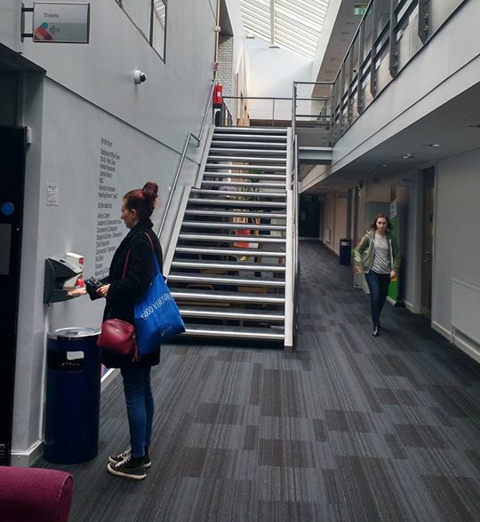
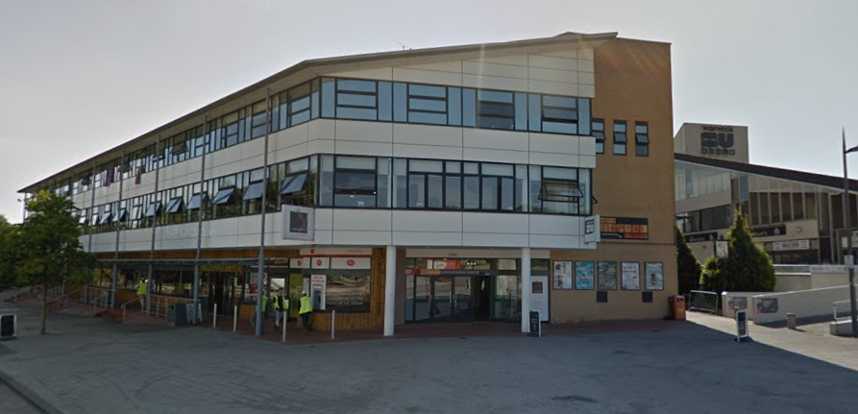
Where is trip sign-up really though?
Trip sign-up will be up one flight of stairs, through the double doors then up these stairs and on the left!
The SUHQ is between Rootes Grocery Store and the SU building
HERE

Slide 5
What should I bring?
Walking boots or trainers
Not jeans!
Warm jumper or fleece
Rucksack
Waterproofs (top and bottom)
Lunch, water and snacks
Some money if there’s time at the pub

Slide 6
Weekend Trips
Sign up is the same format as the day trip
Cost: £50-£55
Minibuses leave on Friday at 5:30pm
Stop for supper/food buying on route
Saturday:
  Full days walking lead by walk leaders
  Evening group meal, fun and games
Sunday:
  Shorter walk lead by walk leaders
  Return to the university for 8pm

Slide 7
Snowdonia Trip
First weekend trip of the year
Open to members and non-members
18th - 20th October
Cost: £55/£60
Where: Chamois Mountaineering Centre

Slide 8
Other Term 1 Trip Locations
Lake District
  Langton Adventure Centre
  1st - 3rd Nov 2019
  (End of week 5)
Snowdonia
  29th Now - 1st Dec 2019
  (End of week 9)

Slide 9
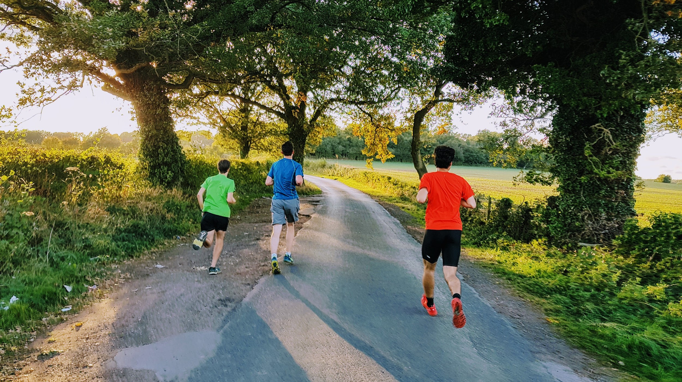

Club Run
Scenery only 5 minutes from campus!
Every Wednesday afternoon
Usually at 5:15, daylight dependent
Various distances and paces
All abilities welcome!
Post-run dinner at 7 pm in the Dirty Duckp
m
Get weekly timing updates on Facebook
facebook.com/groups/WarwickMountains/

Slide 10
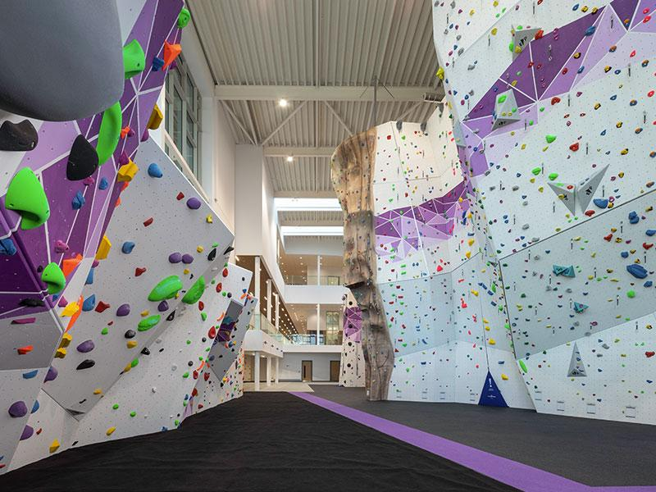
Club Climbing
Every Monday from 5 pm
Where? Warwick Sports Hub
Warwick Sport climbing membership required
Join for bouldering if you do not belay
We do not teach belaying. Warwick University Climbing Club teach belaying
Get weekly timing updates on Facebook
facebook.com/groups/WarwickMountains/

Slide 11
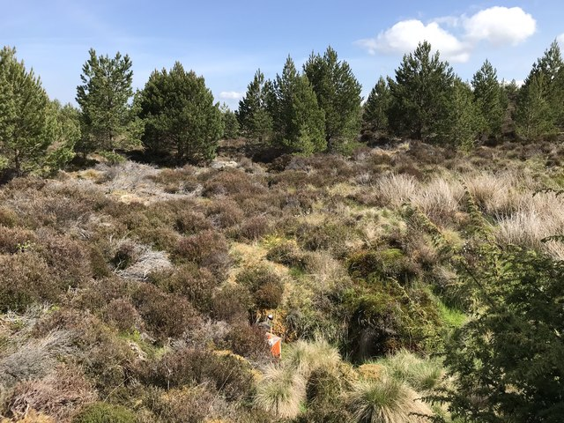
Orienteering
BUCS (Inter-University Competition) Orienteering
  28th - 29th Mar 2020
  Epping and Cambridge
Local orienteering club: Octavian Droobers (OD)
  Frequent Saturday and Sunday events
OMM (26th-27th Oct)
Keep up-to-date on our Facebook group
Events will be posted there
facebook.com/groups/WarwickMountains/

Slide 12
Scotland Tour 2019/20
Snow! Haggis! Whisky!
28th Dec 2019 - Sat 4th Jan 2020
Staying near Ben Nevis!
Cost - £225 ish (+ some equipment cost)
Stay tuned for more info - sign up mid term 1
First day winter skills training from qualified professionals

Slide 13
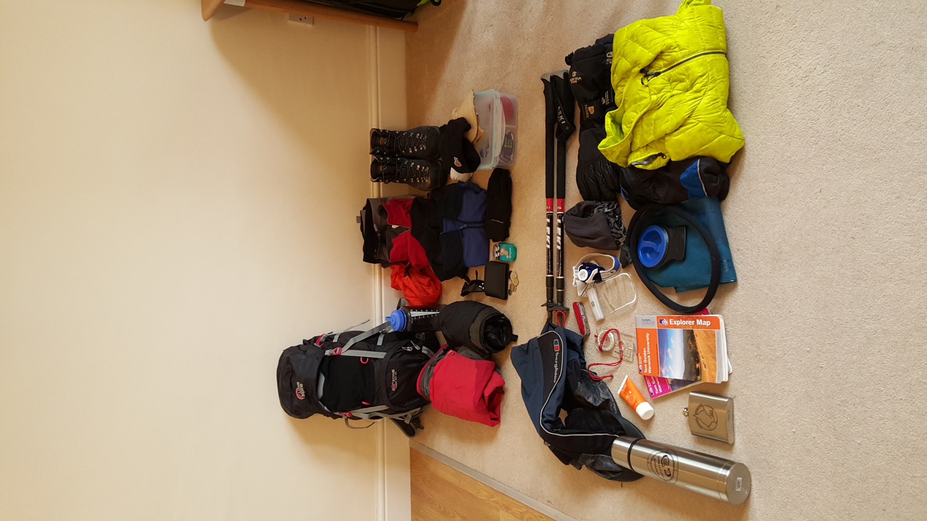
Gear
Example Kit List
Boots (with ankle support)
Waterproof Jacket
Waterproof Trousers
Rucksack
Warm layers
Trousers (Not Jeans)
Hat
Gloves (multiple pairs)
Food
Water Bottle
Sleeping Bag
Optional ironing board
A kit list with descriptions for weekend trips is given on the website.
A limited amount of gear can be borrowed from the club e.g. compasses, maps/map cases, waterproofs, sleeping bags etc.
There is some gear which we expect you to provide for yourself.

Slide 14
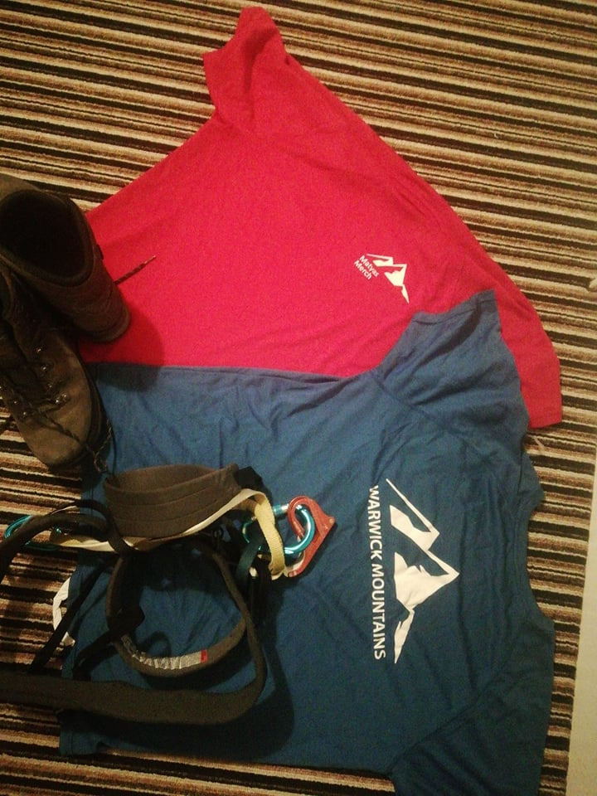
Merchandise
T-shirts, hip flasks, tankards, hoodies…..
Personalised embroidery
Making sure you become a proud representative of the club
Recommendations? What do you want to have? :-)

Slide 15
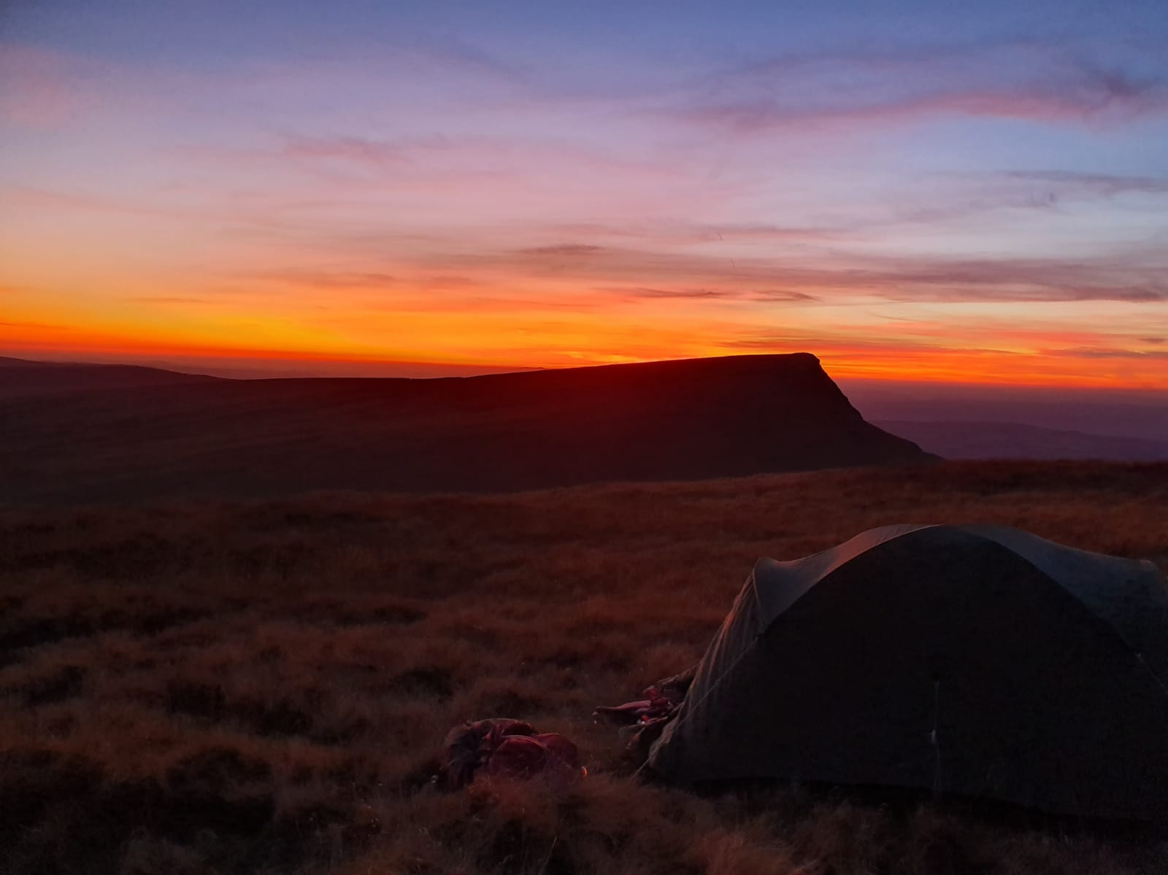
Training
Current Training:
Navigation workshops: Back half of Term 1. Required for Scotland Tour.
Mountain Leader Training; Easter, selection term 2
Future training:
Potential for non mountain leader training sessions
Brecon Beacons, Photocredit: Ella Jeffery

Slide 16
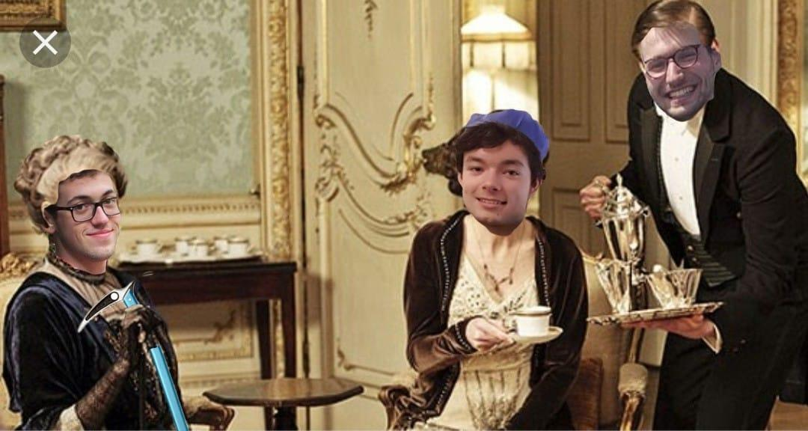
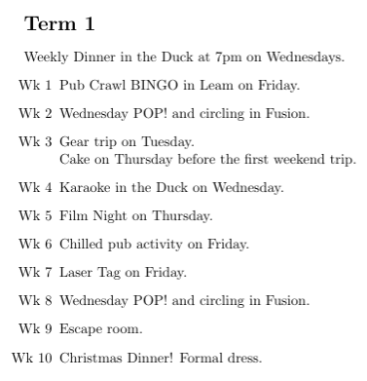
Socials
Facebook events
@Josha Box
@Ella Jeffrey
facebook.com/groups/WarwickMountains/

Slide 17


Circling and POP!
POP! Wednesday weeks 2 and 8
Buy tickets ASAP (5 pounds) via SU website
Circling in Fusion (no ticket needed)
Circling = drinking games in a circle
We are friendly: you can always opt out without penalty

Slide 18
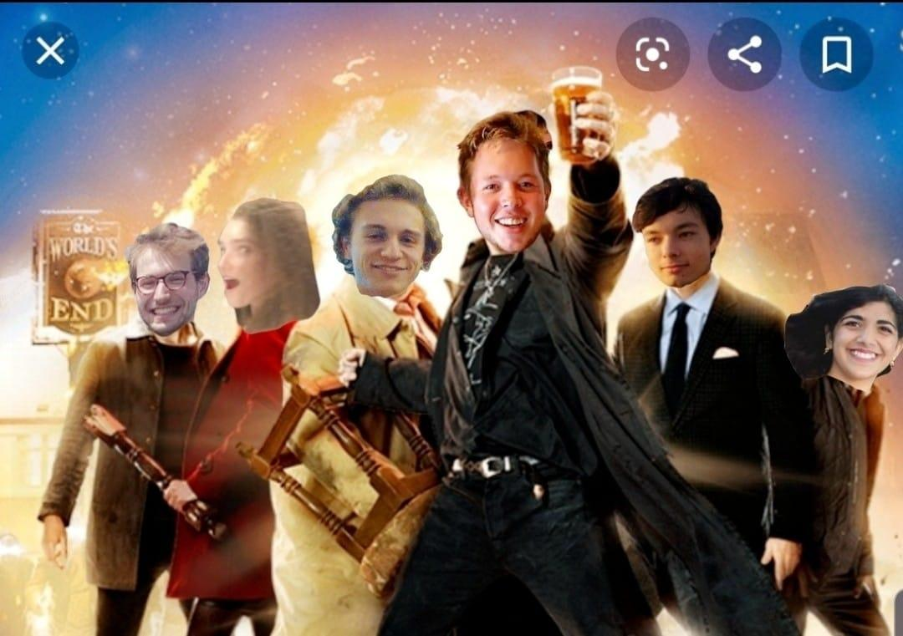
Mountains hits Leamington
Pub crawl bingo
6 pm tomorrow @ bus interchange
6:30 @ The Clarendon

Slide 19
Wellbeing and
Equal Opportunities
Everyone is welcome
Chances to learn new skills
No harassment or exclusion

Slide 20
How to Join the Club
£6 membership
Sports Federation and Off Campus Fee required (required for any sports club, a single payment each year that covers every off-campus club you join).
https://www.warwicksu.com/societies-sports/sports-clubs/mountains/

Slide 21
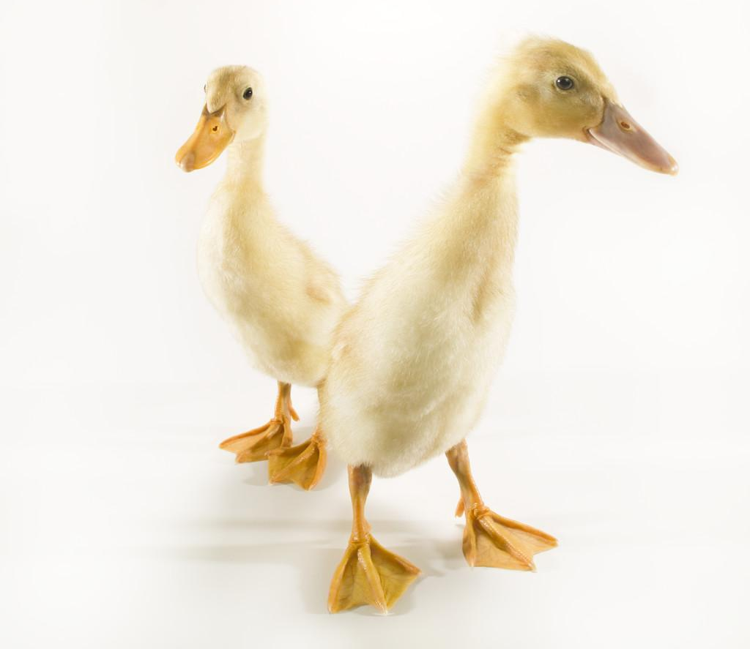
Come and Join us in the Duck after the Talk!
Josha
Ella
Keep up-to-date with club information:
Website: https://www.warwickmountains.com/
Join the club to receive emails
Facebook: https://www.facebook.com/groups/WarwickMountains/

